Slide 1


Topic : Smart Education Domain : Student Innovation Team ID : T317 Team name : Digital Dreamers Team members : T.VARUN(2403A51L05) R.AKASH REDDY(2403A51L30) A. GOUTHAM(2403A51L43) A.VAMSHI KRISHNA(2403A51L47) G.LOKESH(2403A51L60)

Slide 2

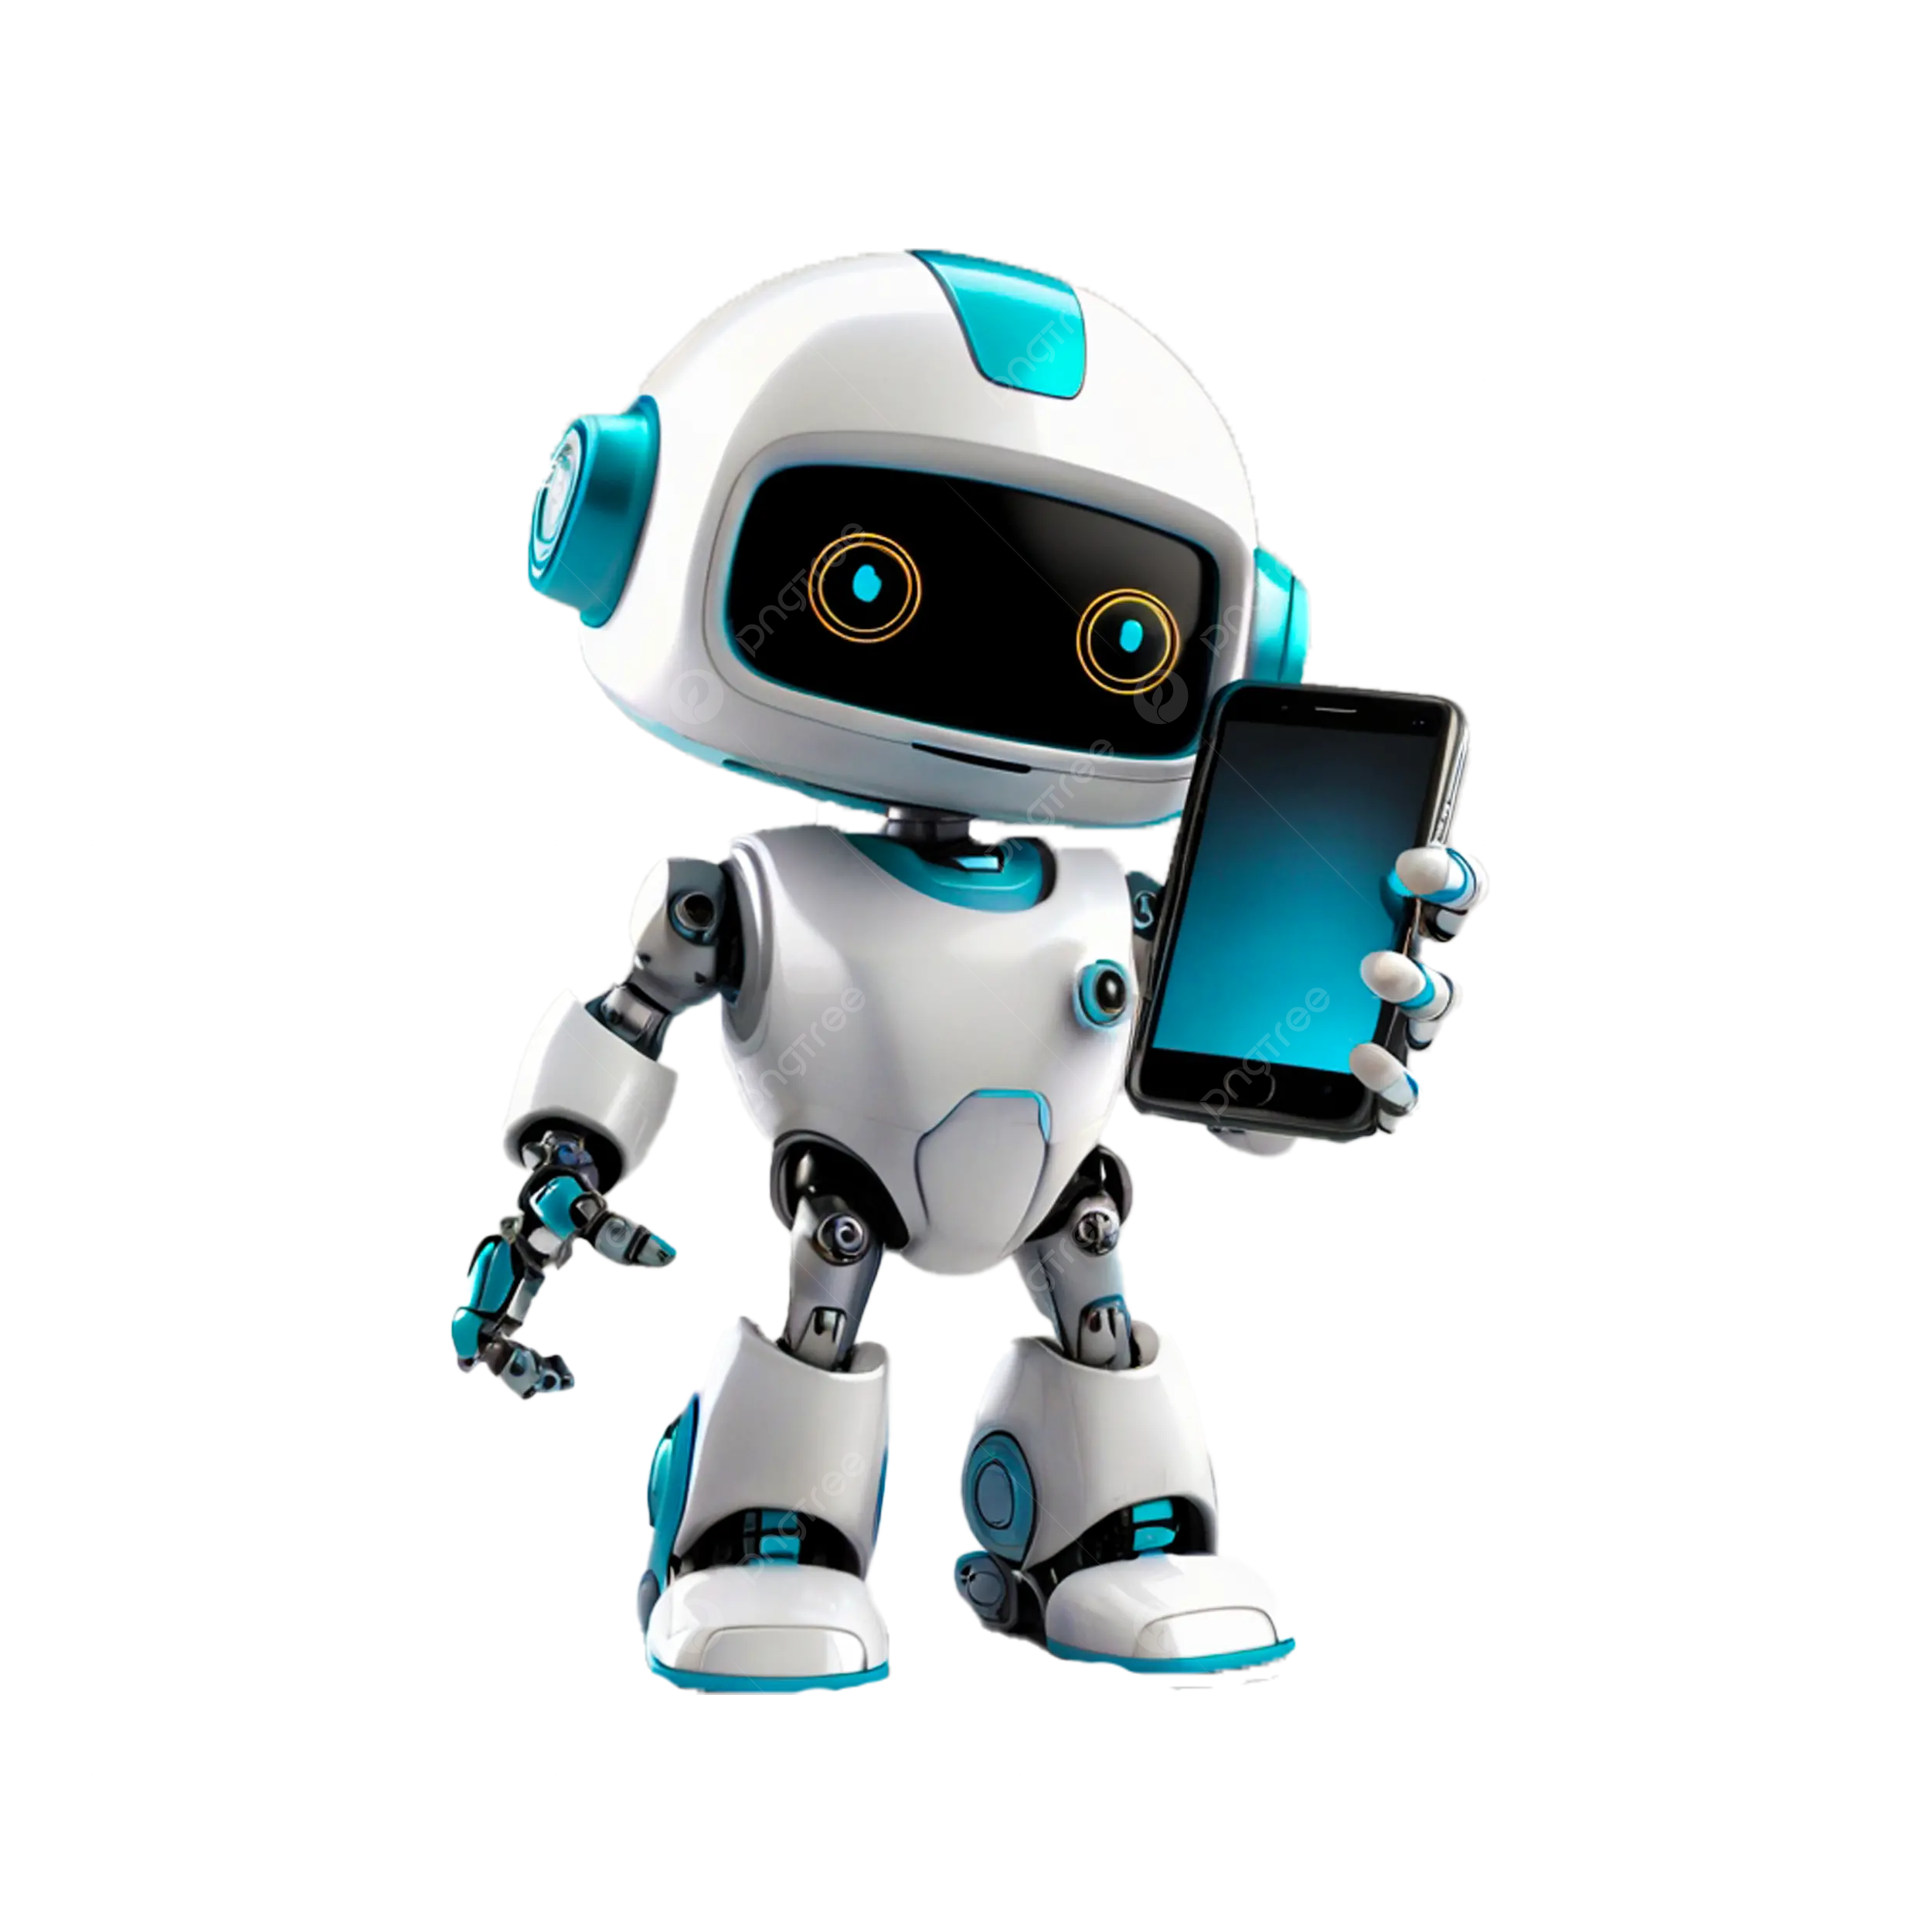
Objective
1.The purpose of this project is to enhance learning through technology, making education more efficient, engaging, and accessible for all.
2.The goal is to enhance learning through technology, ensuring personalized, interactive, and accessible education for all, leading to improved engagement and efficiency.
3.Enhancing education through technology-driven, personalized, and accessible learning for better engagement and efficiency
4.BULLET POINTS:
➤Enhance learning
➤Ensure accessibility
➤Improve engagement

Slide 3

Problem Statement
1.The problem is that traditional education lacks flexibility, personalization, and engagement, making it less effective in today's digital world. 2.Current education systems face challenges like rigid structures, limited access, and low student engagement in a tech-driven era.
3.Key pain points include lack of personalization, limited accessibility, outdated teaching methods, and low student motivation.
4.Students face problems like boring classes, hard-to-understand lessons, poor access, and low interest in learning.

Slide 4
Existing system
The current system uses traditional classroom teaching with fixed schedules, limited technology, and a one-size-fits-all approach.
It lacks personalization, flexibility, and tech integration, leading to low engagement and unequal learning opportunities.
Traditional education is rigid and less engaging, while smart education is flexible, personalized, and tech-driven.
Smart education solves the limits of traditional learning by making it flexible, engaging, and accessible through technology.

Slide 5
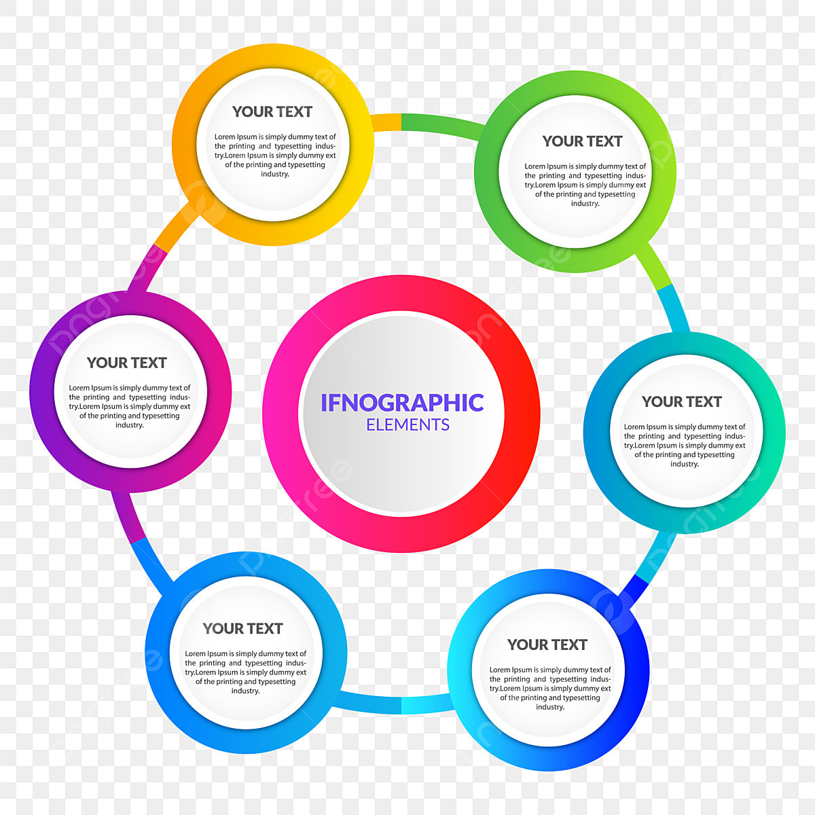
Proposed system
We are developing a Smart Education system that uses technology to make learning more personalized, interactive, and accessible.Highlight its advantages over the existing system.
Key features include AI-based personalization, interactive tools (AR/VR), real-time feedback, and anytime-anywhere access to learning.
Key features include personalized learning, interactive content, real-time feedback, and flexible access through smart technology.
The system ensures a structured flow of information through organized content, smart navigation, and guided learning paths.

Slide 6
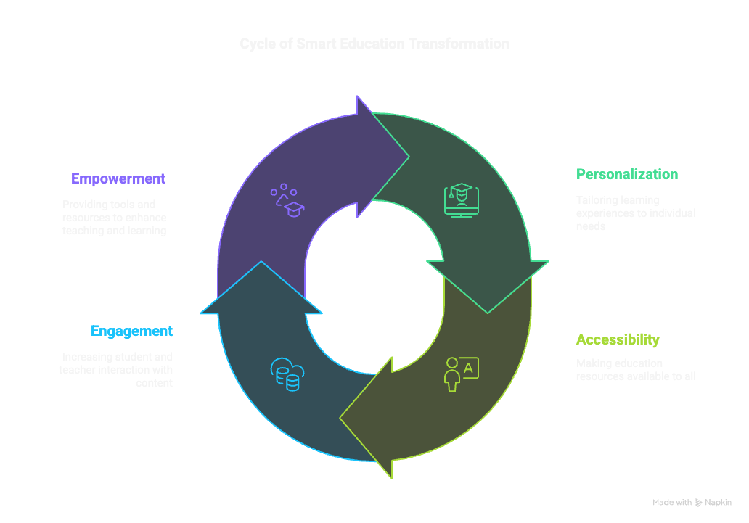
Workflow

Slide 7
System Architecture
Tech Stack
Key points to cover
Python
Architecture.
Maintain a clean and organized layout.
Smarter learning through technology.
"Smarter learning through technology."
SQL
Encryption
REST API
Personalization

Slide 8
Conclusion & Future Scope
➤Smart Education improves learning by making it flexible, personalized, and engaging.
➤It benefits both students and teachers with better access and interactive tools.
➤ Future updates may include advanced AI tutors, voice interaction, and expanded AR/VR features.
➤ The system is designed to grow with technology and learner needs.
➤Empowering education for a smarter tomorrow.

